Slide 1

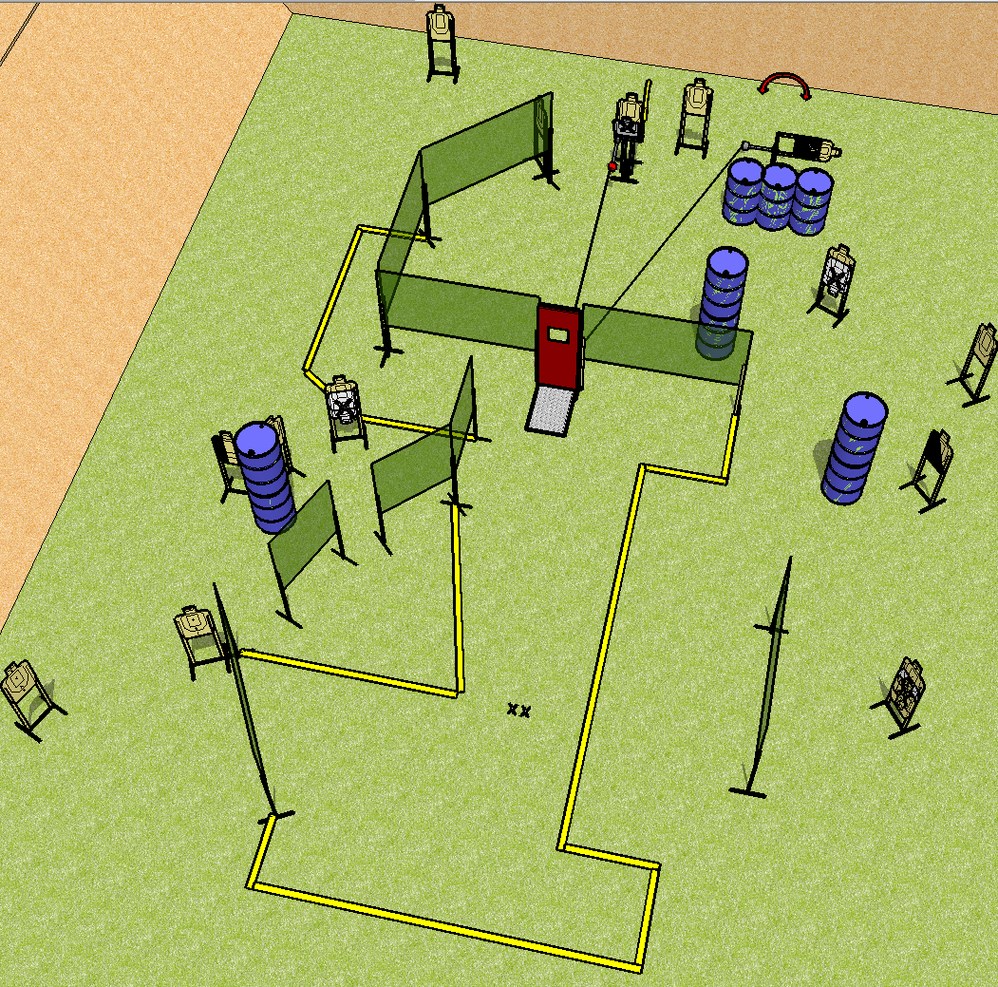
 | Dothan Practical Shooters – USPSA Match Portside Pain Course Designer : Drew Coleman Bay: B1
Round Count 30 rounds 15 USPSA
Equipment List 17 wall feet Pull cord port Max trap + swinger + cables to the pull cord 1 tux, 1 right diag, 1 lower 1/3rd hard cover, 15 targets (4 NS)

Slide 2
Portside Pain
Written Stage Briefing
Scoring: Comstock Rounds: 30
Targets: 15 USPSA
Handgun start position: feet on X’s, wrists below belt. Handgun is loaded and holstered.
PCC start position: feet on X’s, stock on belt. Loaded carbine is held with both hands, safety on.
Stage Procedure: on the audible start signal, engage targets as they become available from within the shooting area.

